Slide 1


DEPARTMENT OF PHARMACEUTICAL CHEMISTRY,
SCHOOL OF PHARMACY,
UNIVERSITY OF ATHENS, GREECE
Can pharmacogenetic testing lead to individualized therapy? Studying the case of omeprazole by utilizing LC-MS/MS and Real Time-PCR protocols
Yannis Dotsikas
Lecturer of Pharmaceutical Analysis

Slide 2
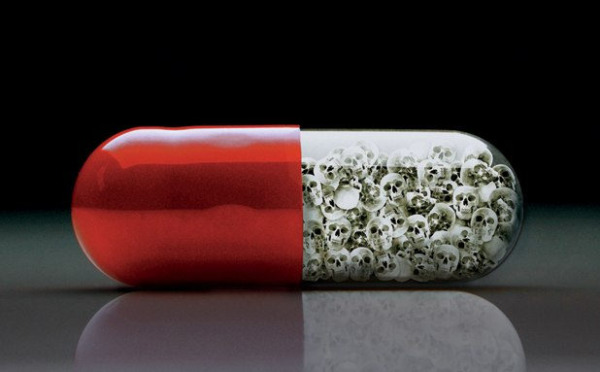
The progress in Pharmacology and Molecular Biology has allowed better understanding of their mechanism of action and the appearance of their Adverse Effects
Especially for Adverse Effects, it is now clear that PERSONAL TEMPERAMENT can play a very critical role
2,200,000 people in US are hospitalized due to drug adverse events and ~ 100.000 from these die* (One size fits all approach)
* Lazarou, et al., JAMA 279 (1998) 1200
2

Slide 3
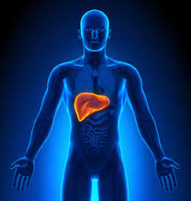
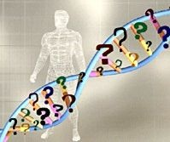
59% of drugs related to Adverse Effects, are metabolized by liver enzymes for which certain gene variations have been described*
Inter-individual variability
Individualized pharmacotherapy: Administration of the most effective & safest drug (right dose) to each patient, based on his/her genetic profile and other parameters
* Philips, et al., JAMA 286 (2001) 2270

Slide 4
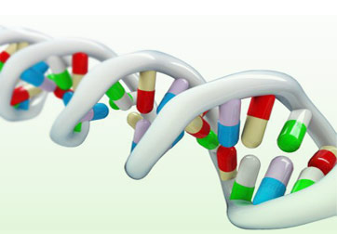
Definition of pharmacogenetics
Study of the effect of genetic variations located in one or more genes on drug response (efficacy & adverse events-safety).
Definition of pharmacogenomics
Study of the effect of genetic variations scattered throughout the human genome on drug response (efficacy & adverse events-safety) (prediction of new structures, study of mechanisms of action, reevaluation of old drugs etc).
Pharmacogenomics contains pharmacogenetics
(although many use one term instead of the other)

Slide 5
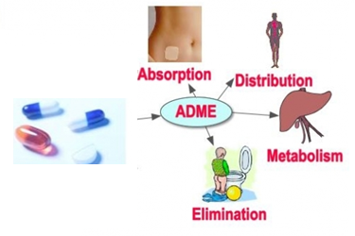
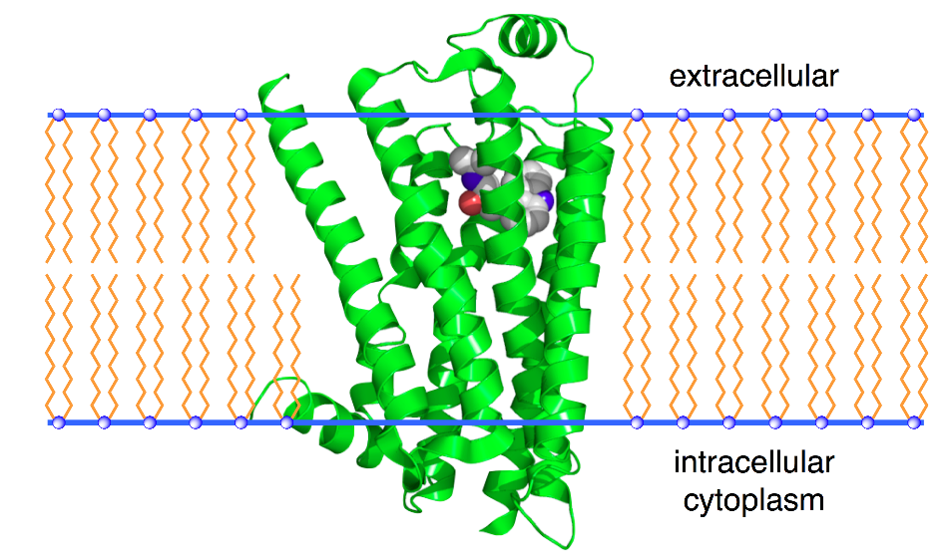
IDENTIFICATION OF GENETIC DIVERSITY
Pharmacokinetics
-Absorption
-Distribution
-Metabolism
-Excretion
Pharmacodynamics
-Receptors
-Enzymes
-Ion channels

Slide 6
Mutations can modify the function of the coded protein (enzyme)
*
Functional enzyme
Modified enzyme –
But still functional?

Slide 7
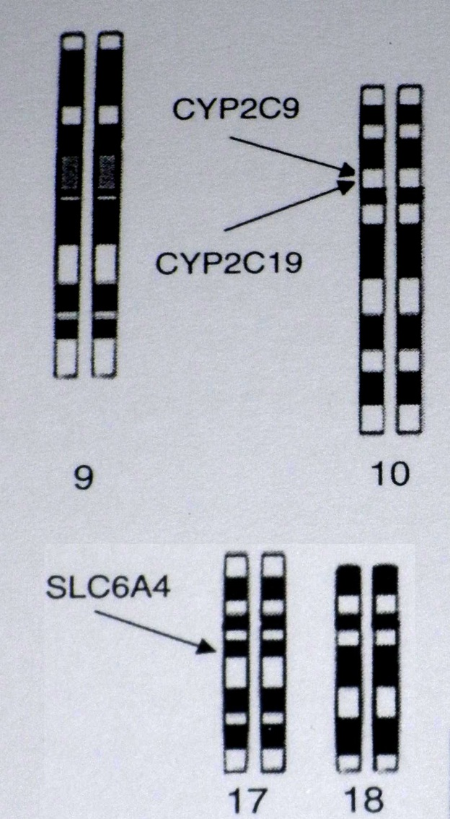
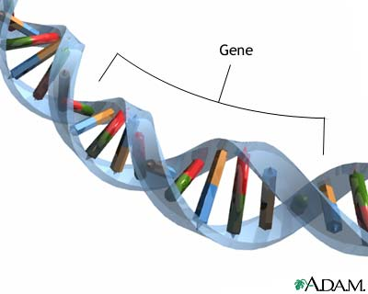
Genes to be tested…..
CYP2D6
CYP2C9
CYP2C19
CYP3A4
CYP3A5
CYP1A2
COMT
VCORC1
HTR1A
HTR2A
HTR2C
SLCO1B1
SLC6A2
SLC6A4

Slide 8
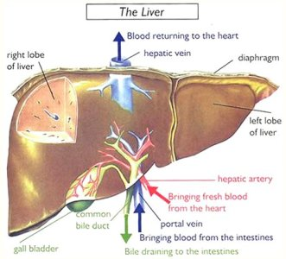
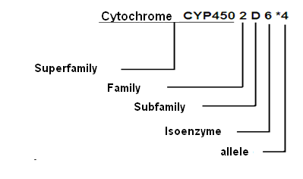
Pharmacogenetics & Metabolism
The majority of drugs is metabolized via liver. The main liver mechanism for biotransformation includes family of enzymes P-450 which consists more than 50 isoenzymes.
Regularly, more than one enzyme is interfered in drug metabolism.

Slide 9
Extensive (Normal) metabolism | Patients metabolize drugs normally at the recommended doses.
Intermediate metabolism | Patients metabolize drugs slower. They may need lower dose and there is possibility of drug accumulation causing adverse effects. It is important to monitor drug safety and efficacy in such cases.
Poor metabolism | Patients can metabolize drugs at a very slow rate. This kind of metabolism is potentially dangerous, since there is strong possibility for drug accumulation, leading to numerous and serious adverse events.
Ultra-rapid metabolism | Patients in this category metabolize ultra rapidly drugs administered at the recommended doses and therefore the therapeutic benefit is reduced.

Slide 10
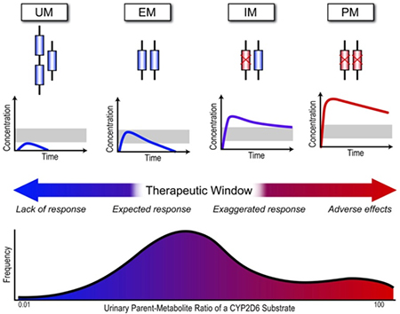
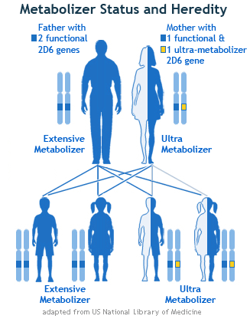
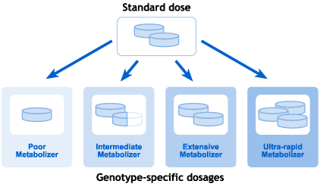

Slide 11
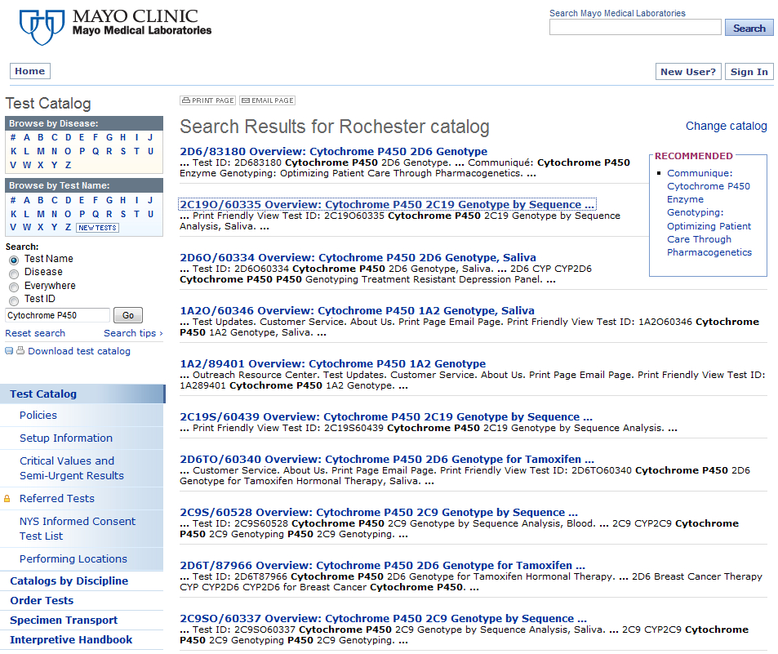

Slide 12
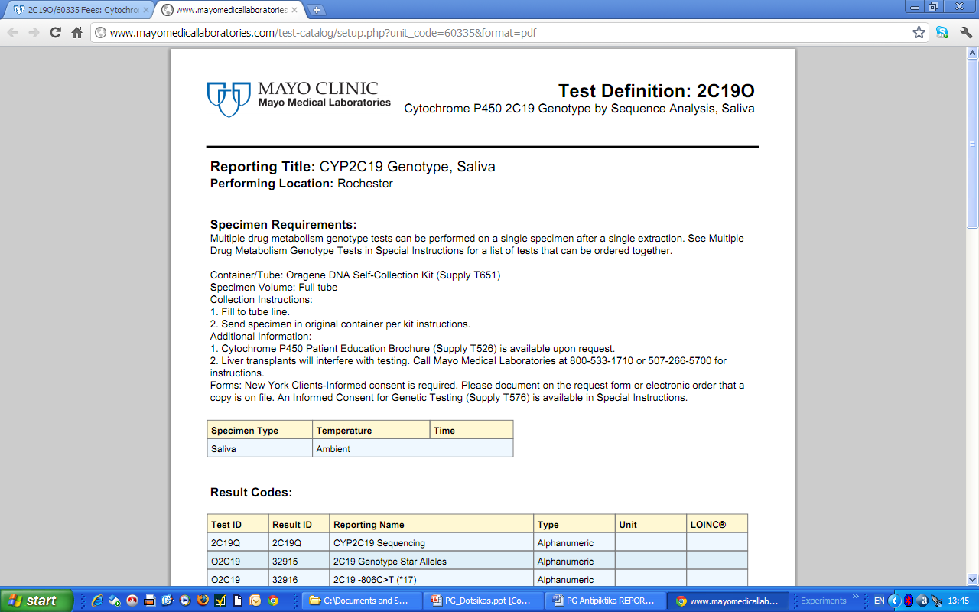

Slide 13
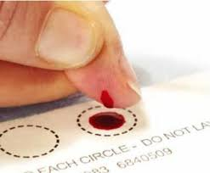

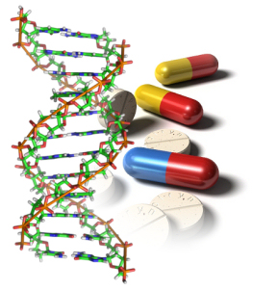
DNA extraction from whole blood or buccal cells.
The collection of buccal cells is a non invasive method of sampling.
Sampling can be performed by the patient himself.

Slide 14
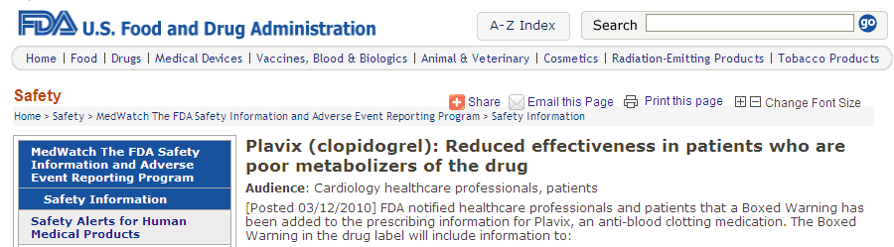
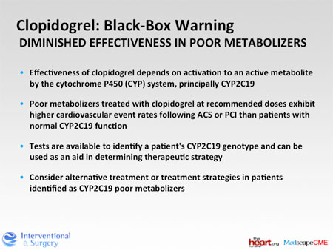
The case of CLOPIDOGREL: FDA suggests pharmacogenetic test of CYP2C19 gene prior to initiation of anticoagulant treatment

Slide 15
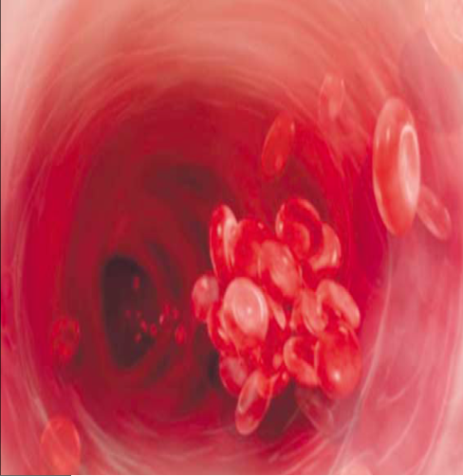
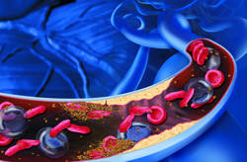
Clopidogrel is the standard treatment of acute coronary syndromes
It is administered in inactive form (prodrug) and is converted into the active metabolite with anticoagulant action
Polymorphisms (SNPs) of the gene CYP2C19 can affect enzyme activity,
leading to different drug response.
CYP2C19 *2 & *3 alleles are identified in the majority of poor metabolizers = causing insufficient biotransformation of clopidogrel and therefore insufficient response to treatment
CYP2C19 *17 allele is associated with the phenotype of the ultra-rapid metabolizer = causing very rapid biotransformation of clopidogrel and therefore appearance of adverse events (bleeding)

Slide 16

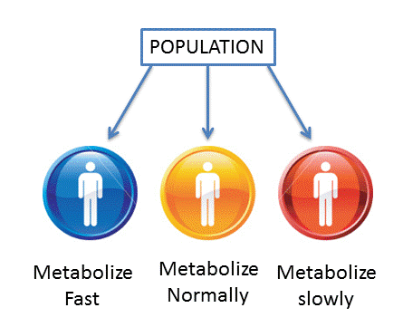
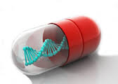
The alleles, associated with abnormal metabolism, are encountered in up to 30%!!! of Caucasian populations.
Classification | Caucasian | African Amer. | Asian
Normal (extensive) | 70 | 40 | 50
Intermediate | 5 | 30 | 45
Poor | 7-10 | 15-20 | 1
Ultra Rapid | 5-15 | 2-20 | 2

Slide 17
In case of enzymes with modified activity, the term Drug Interaction is of greater significance!!!
Other cases of drugs are also substrates of the same enzyme CYP2C19, such as antidepressants, anxiolytics, anticonvulsants, proton pump inhibitors (i.e. omeprazole, Losec).
Other drugs act as inducers of the enzyme CYP2C19.
Other drugs act as inhibitors of the enzyme CYP2C19.

Slide 18
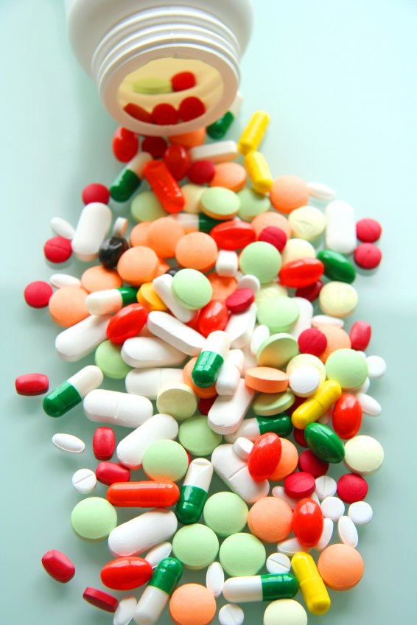
Antidepressants*
Normal use |  | Use with caution |  | Use with big caution and close monitoring
Bupropion Desvenlafaxine Selegiline |  | Amitriptyline Citalopram Clomipramine Escitalopram Imipramine Sentraline Trazodone |  | Desipramine Duloxetine Fluoxetine Fluvoxamine Mirtazapine Nortriptyline Paroxetine Venlafaxine
* Based on genotype and current scientific knowledge

Slide 19
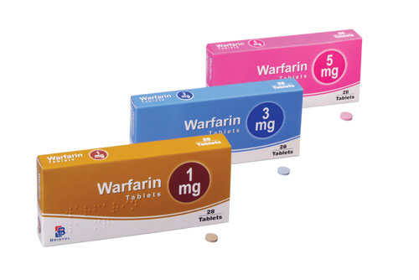
Dose adjustment based on pharmacogenetic testing
(Warfarin) mg per day**
 | VKORC1 GG |  | VKORC1 AG |  | VKORC1 AA
CYP2C9 mut | Initial | % decrease | Initial | % decrease | Initial | % decrease
Wild type | 5.6 |  | 4.5 | 20 | 3.5 | 38
Het *2 | 4.5 | 20 | 3.5 | 38 | 2.7 | 52
Het *3 | 4.0 | 29 | 3.1 | 45 | 2.3 | 59
Hom *2 | 3.5 | 38 | 2.7 | 52 | 2.0 | 64
Comp. Het *2/*3 | 3.1 | 45 | 2.3 | 59 | 1.6 | 71
Hom *3 | 2.6 | 54 | 1.9 | 66 | 1.3 | 77
This Table is a suggestion for a doctor

Slide 20

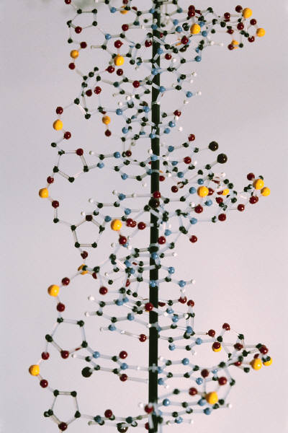
SOS: Pharmacogenetic testing is not a solution for everything
Many factors can affect inter-individual variability, besides genotype (and physician has in mind)
- age
- sex
- body mass
presence of diseases such as
renal / liver failure
- drug comedication
- formulation
Pharmacogenetic testing can be the link between doctors, clinical laboratories and pharmacists
+

Slide 21
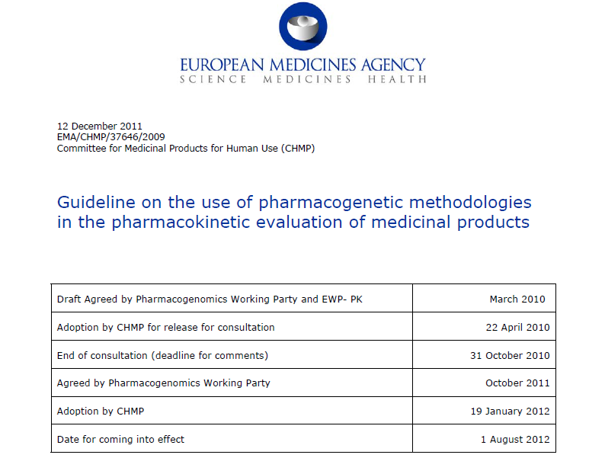

Slide 22
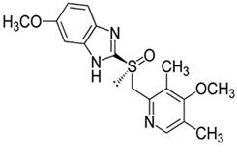
Omeprazole and pharmacogenetics
-Proton-pump inhibitor
-metabolized by enzyme CYP2C19 which is coded by CYP2C19 gene
-Effect of PGx on pharmacokinetics can be studied by
LC-MS/MS (determination of plasma concentrations)
Real Time-PCR (genotype identification for CYP2C19 *2, *3 & *17 alleles)

Slide 23
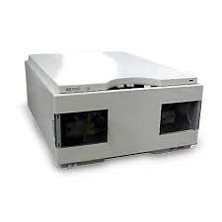
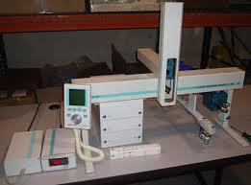
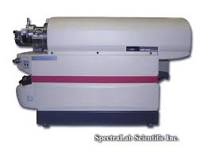
Determination of omeprazole in plasma via an automated LC-ESI-MS/MS method
Basic instrumentation
Agilent 1100 pump CTC-PAL autosampler API 2000 MS/MS

Slide 24
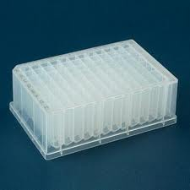
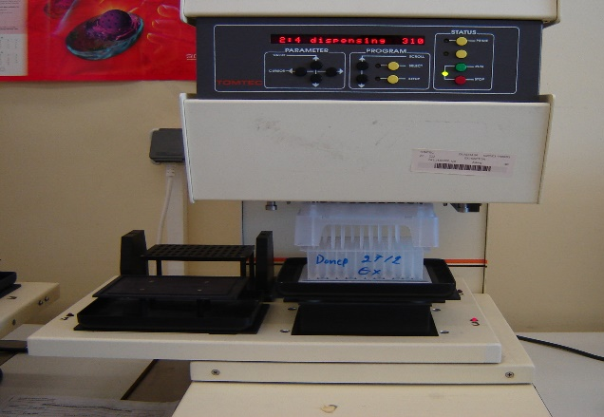
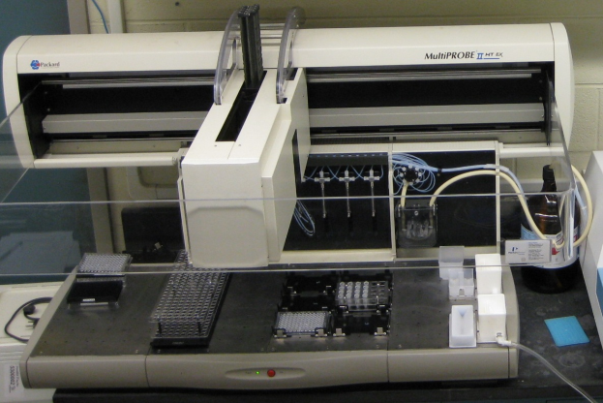
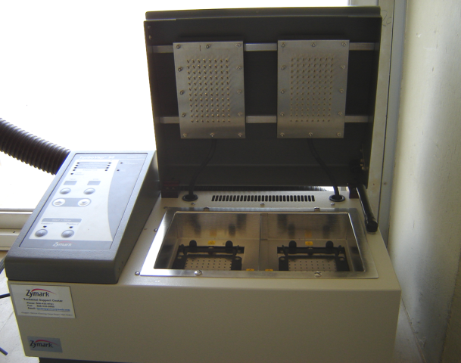
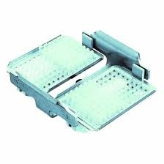
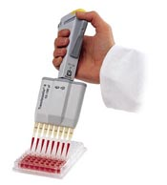
Determination of omeprazole in plasma via an automated LC-ESI-MS/MS method
Automation
96-well plates Tomtec Quadra 96 Perkin-Elmer Multiprobe
Zymark N₂
evaporator
Eppendorf centrifuge

Slide 25
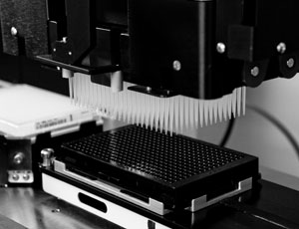
Determination of omeprazole in plasma via an automated LC-ESI-MS/MS method
Automation offers:
High throughput (> 400 samples daily)
Minimization of errors
Less analysts involved
One BE study with 1000 samples can finish in 2-3 days!!

Slide 26
Determination of omeprazole in plasma via an automated LC-ESI-MS/MS method
Sample preparation:
Blood sample centrifugation – receipt of plasma
100 μL plasma (standard/QC/unknown) + 50 μL pantoprazole solution (Internal standard) in MeOH (PP)
1200 μL ethyl acetate, Vortex
Centrifuge
Freezing
900 (3x300 μL) organic layer placed into new plate
Evaporation
Reconstitution

Slide 27
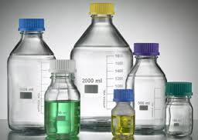
Determination of omeprazole in plasma via an automated LC-ESI-MS/MS method
Chromatographic analysis:
YMC C8 column (50 x 4.6 mm, 3μm, 120 Å)
0.500 mL/min flow rate
Run time = 1.5 min
Mobile phase:
75% ACN, 25% HCOOH 10 mM

Slide 28
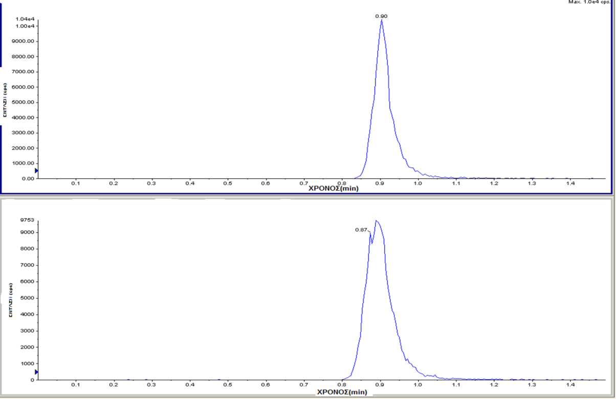
Daughter scans
MRM chromatograms

Slide 29
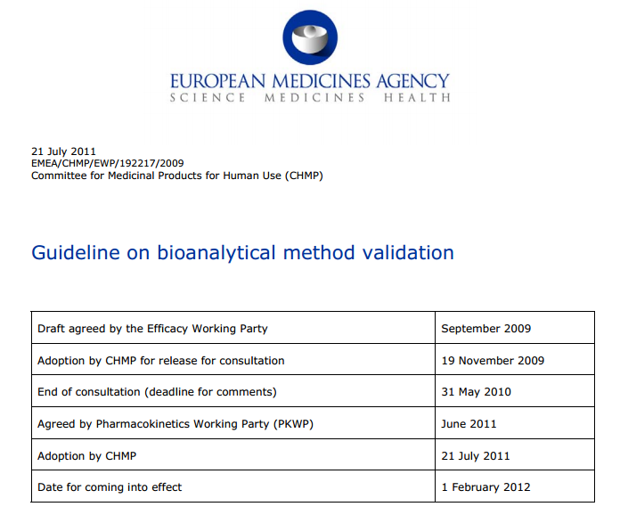

Slide 30

Validation of LC-ESI-MS/MS method
Specificity
Linearity
Precision
Accuracy
Carry-over effect
Stability (long-term, short-term, autosampler, freeze/thaw, stock/working solution)
Extraction Recovery
Matrix effect
Incurred Sample reanalysis
Dilution integrity

Slide 31
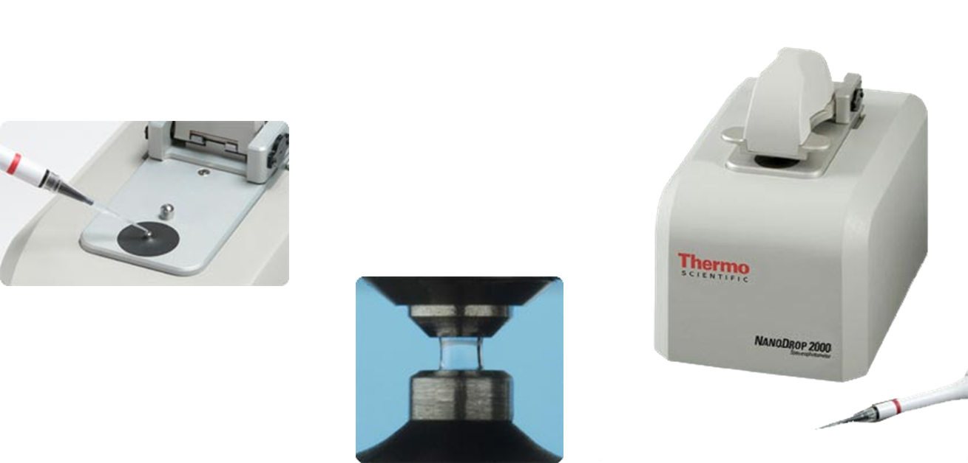
Genotyping from DBS
DNA extraction from DBS via Chelex protocol
Determination of DNA quality via Nanodrop (A260nm/A280nm)
STEPS:

Slide 32
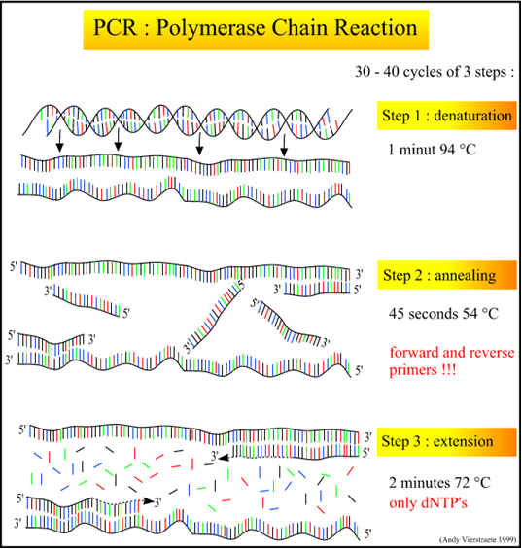
Genotyping from DBS
3. Real-Time PCR protocol
STEPS:

Slide 33
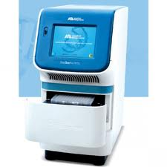
The total volume of the PCR reaction = 25 μL
The cycling conditions were as follows: 50ºC for 30s (1 cycle), 95 ºC for 10 min (1 cycle), 95 ºC for 15 s and 59 ºC for 90 s (50 cycles), 50 ºC for 1 min (1 cycle).
One positive control, as well as a non-template control, were also included in each run.
ABI StepOne Plus

Slide 34
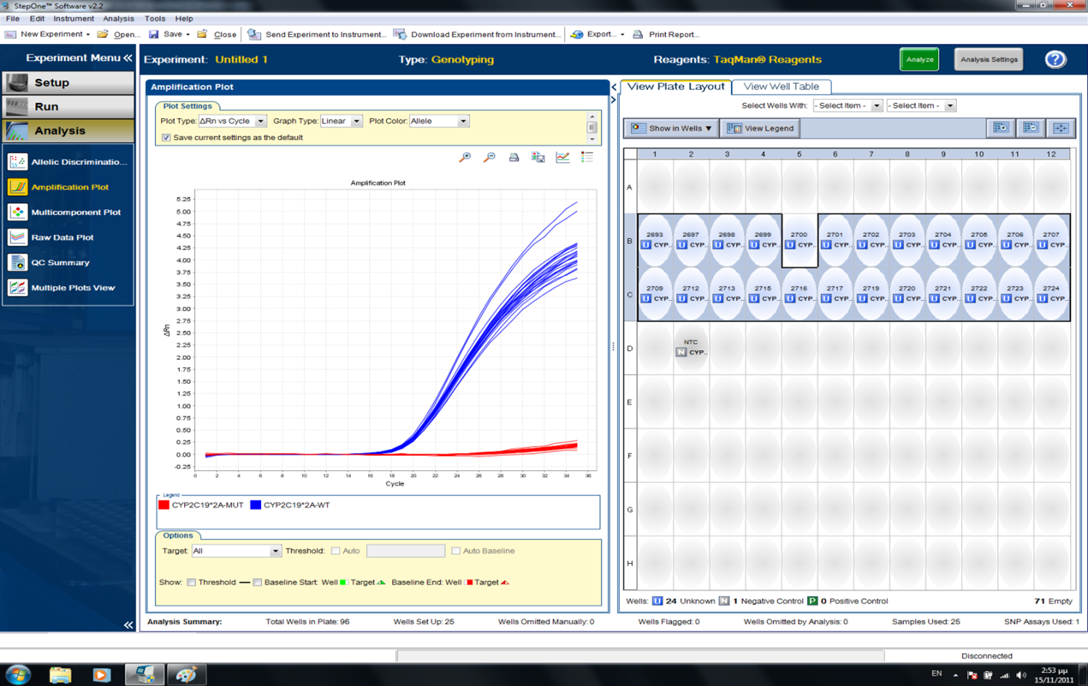
Wild-type

Slide 35
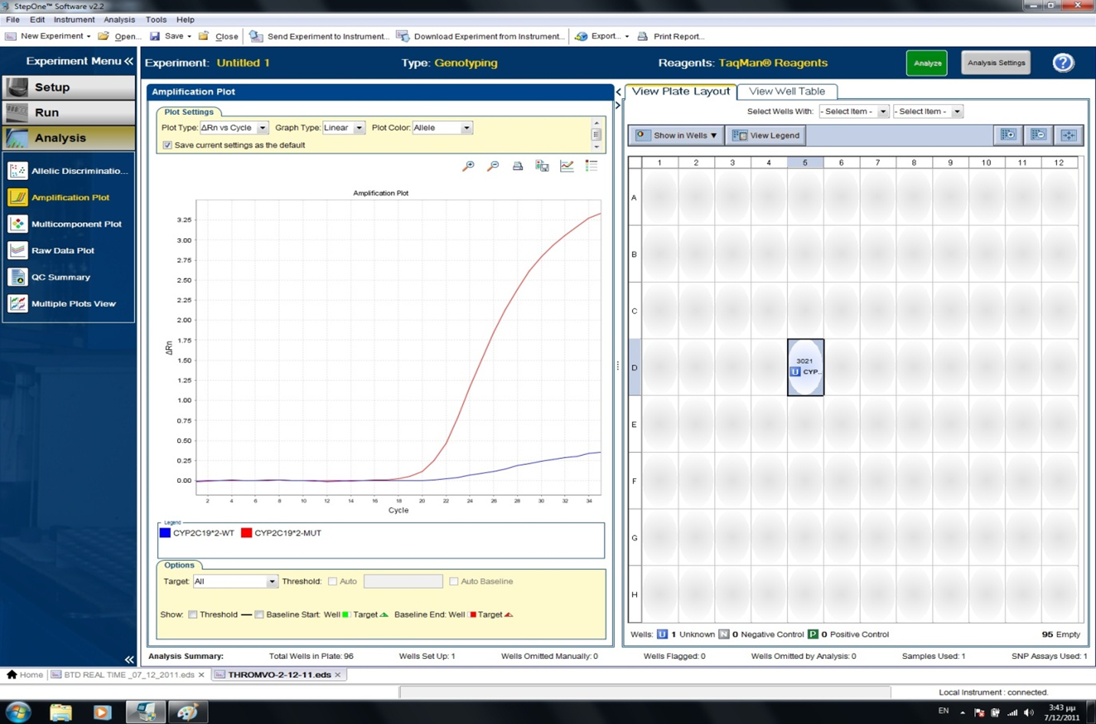
Homozygote

Slide 36
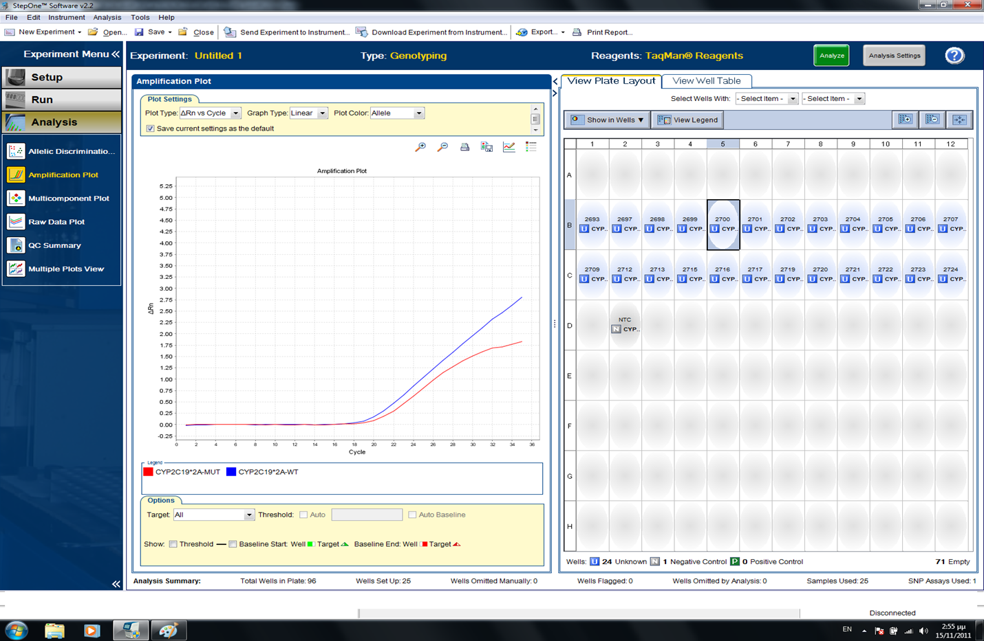
Heterozygote

Slide 37
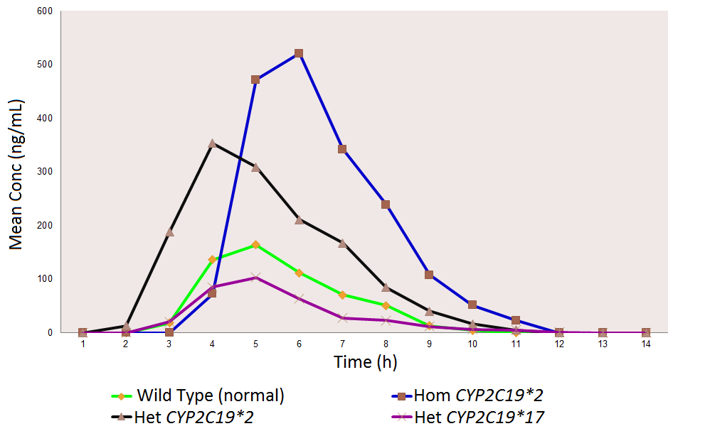
40 volunteers

Slide 38

Thank you!

Slide 39
